Slide 1



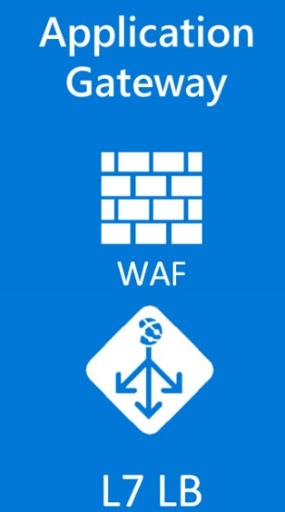
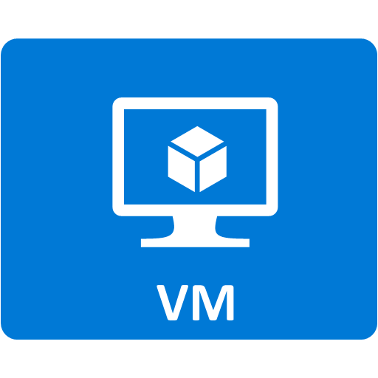







Proof of concept solution
Azure Management & Monitoring
Cloud Shop Application
Security Center
hackathonVNet
Unified view into the security posture of hybrid cloud workloads
Detect and respond to threats
AppGWVNet
VNet Peering
Log Data
Log Analytics
Single pane of glass for operational data
Azure Mobile App
Public IP
App GW
Azure Monitor
App Telemetry
Custom Notifications and Alerts
Environment Recommendations
Application Insights
Run-Time Application Telemetry Provided by Status Monitor
Web and Performance Testing
Automation DSC
WWW
SUBNET
DATA
SUBNET
Azure Automation
Desired Configuration Management using Runbooks
Update Management via Schedules using the Patch Management Solution
Change Tracking
VM Extension:
Azure DSC
App Insights:
Status Monitor
VM Agent

